Slide 1

Aurubis Buffalo
Waiting Time Analysis For Coil Production
-Group 17

Slide 2

Content
Data Cleaning & Handling
Dealing with Missing Values
Calculating Waiting Time
Exploratory Data Analysis
Attributes Data Visualization
Sanky Diagram
Waiting Time Model
Feature Engineering
Model Building:
Model Selection
Random Forest
Neural Network
Linear Regression
Bayesian Ridge
Light GBM
K Nearest Neighbor
Conclusion

Slide 3
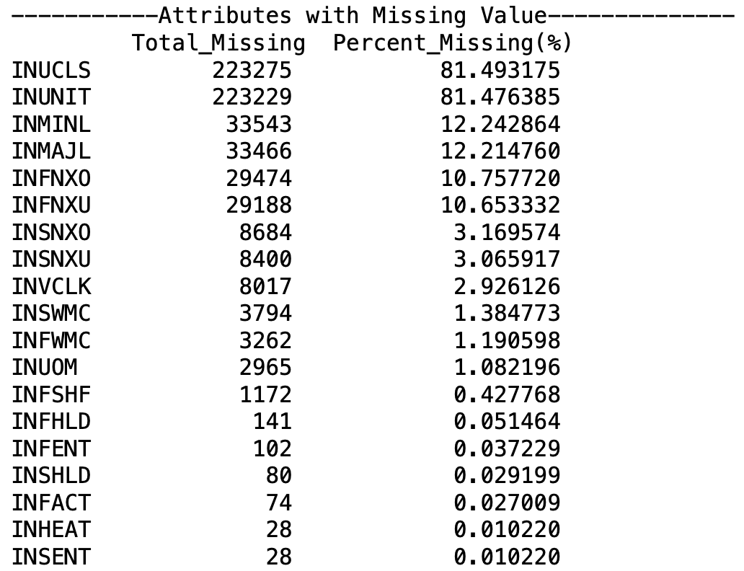
Part1: Data Cleaning
Drop Unrelated Attributes with Waiting Time Model
INMINL(Minor Location), INSTRN(Instruction)…
Missing Value
Drop the attribute which have more than 50% missing value
Other: Listwise deletion if attributes are necessary after feature engineering
Transform Data Type
Some categorical variables represented by number (INSNXU/next unit)
Separate categorical variables and numerical variables
Drop Attributes
Total number of missing values of each attribute &
Percentage of missing values of each attribute in descending order
Notes:
Listwise Deletion: Delete all data from any participant with missing values. If your sample is large enough, then you likely can drop data without substantial loss of statistical power. Be sure that the values are missing at random and that you are not inadvertently removing a class of participants.

Slide 4
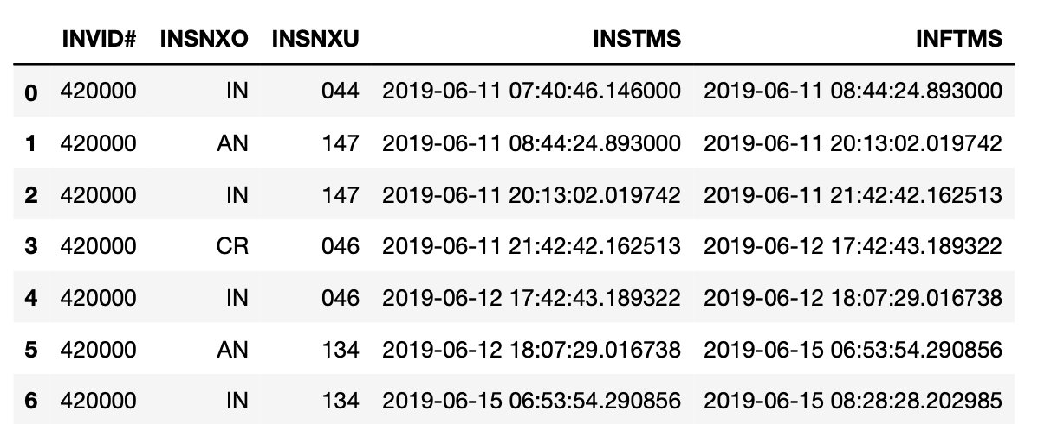
Part1: Calculating Waiting Time
Inventory #
Next Operation
Next Unit
Start Timestamp
Finish Timestamp
Waiting Time (In Hour)
N/A
11.477222
20.000278
60.773611
Example: 2019-06-11 20:13:02 - 2019-06-11 08:44:24 = 11.477 h
Only focus on IN status (INSNXO/Next Operation)
Machine Waiting Time =
Start timestamp of this IN operation (INSTMS of this row) –
Finish timestamp of last IN operation (INFTMS of last row)

Slide 5
Part2: Exploratory Data Analysis
Order Perspective
 | Wait Time (Hour)
Average | 59.06
Max | 4379.16
Upper Quartile | 61.01
Median | 38.145
Lower Quartile | 22.195
Min | 0
Short wait time: wait time < lower quartile
Medium wait time: lower quartile ≤ wait time ≤ upper quartile
Long wait time: wait time > upper quartile

Slide 6
Part2: Exploratory Data Analysis
Order Perspective (Con’d)
The wait time of on scheduled orders is almost half of wait time of delay orders
Analysis and prediction on wait time can help to solve order delay problem

Slide 7
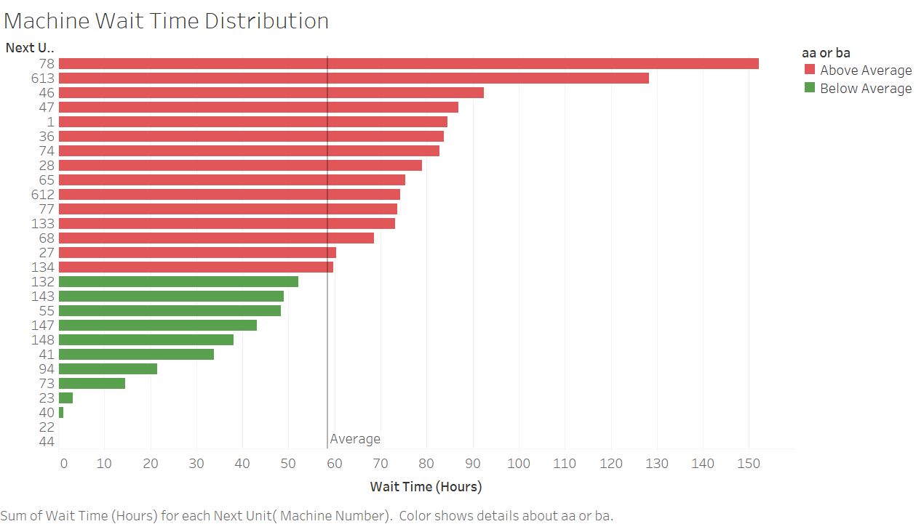
Part2: Exploratory Data Analysis
Machine Perspective
Wait time for machine 78 is the longest
Wait time for machine 22 and 44 is the shortest
Average wait time for all machine is 58.5 hours

Slide 8
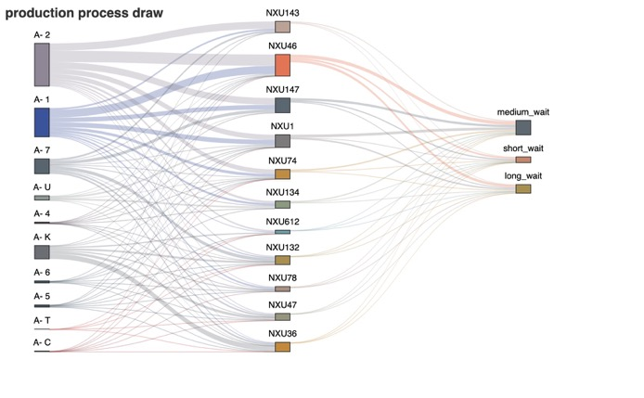
Part2: Exploratory Data Analysis
Process Analysis (Sankey Plot)
Most of alloy type of coils are A-1, A-2, A-K and A-7 (alloy type)
A-2 coils are more likely to go to the machine 143 (short wait)
A-1 coils are more likely to go to the machine 46 (long wait)
A-7 coils are more likely to go to machine 132 and 147 (short wait)
A-K coils are more likely to go to machine 36 (long wait)
Alloy
Machine Number
Wait
Time

Slide 9
Part3: Why We Need Target Encoding to Deal with Features
Difficulty 1 Comments
Too Many subcategories (>=10) in some categorical variables
Some variables (i.e., INALLY) can use the first digit to represent but for most of them, hard to manipulate;
Need more instructions about the meaning of those categories to manipulate!
Difficulty 2 Comments
Traditional Encoding Methods are NOT Suitable
One-hot encoding will create too many dimensions, but we have only 270,000 operation data;
Integer encoding does NOT work because there is NO ordered relationship between each other.

Slide 10
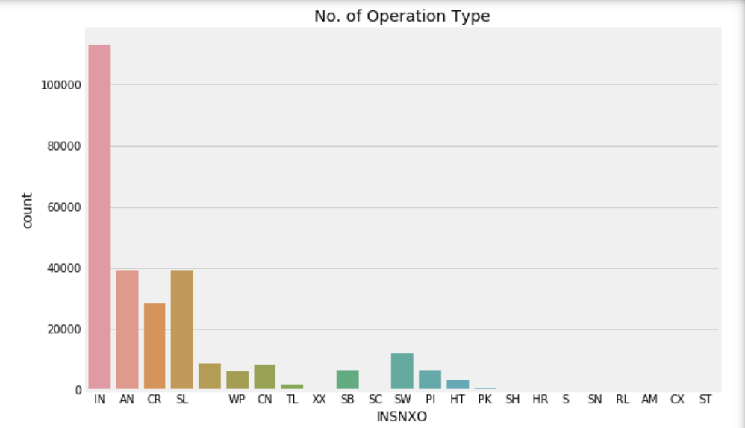
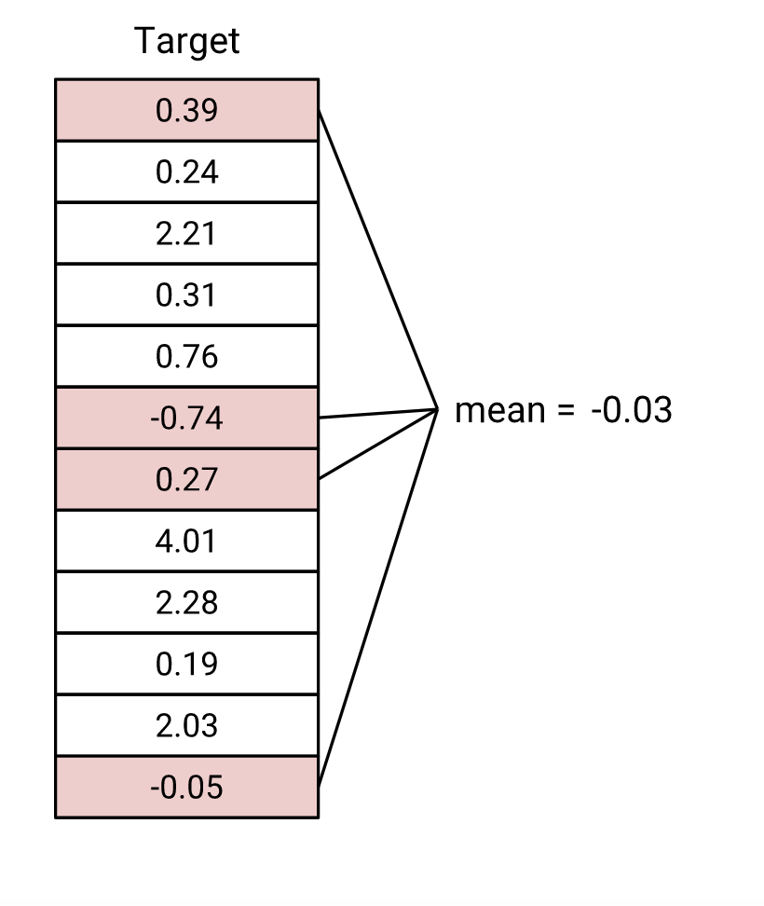
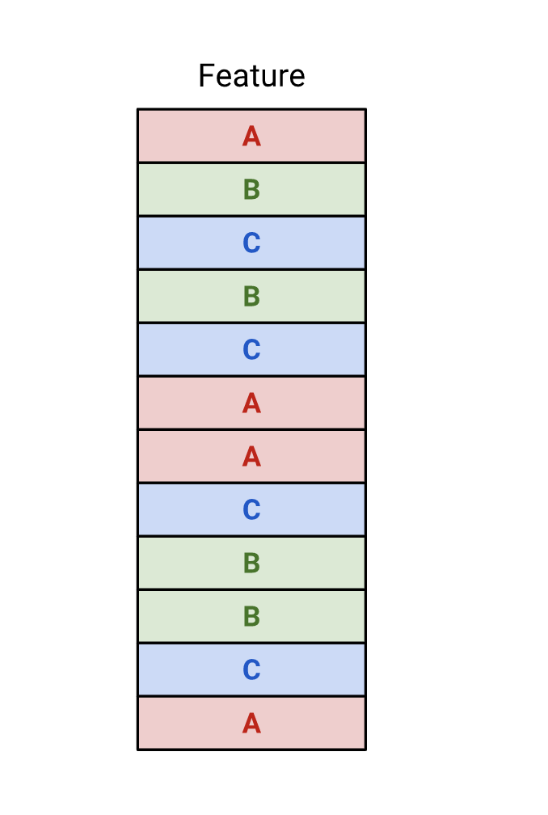
Part3: Target Encoding for Categorical Variables
How We Implement Target Encoding?
Advantages of Target Encoding
Example: INSNXO
Simply Replace Category with Mean Target Value
Retain actual useful
information
Keep Original Dimensionality
Why is Mean encoding Great for our Dataset?
Can embody the target in the label
could prove to be a much simpler alternative
tend to group the similar classes
Waiting Time
Categorical Variable

Slide 11
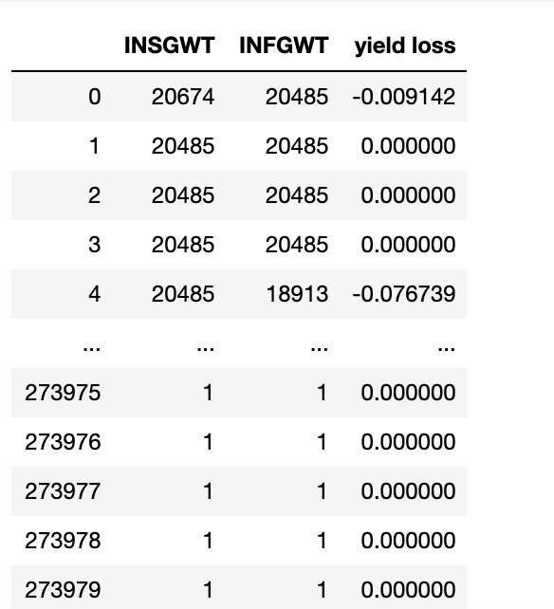
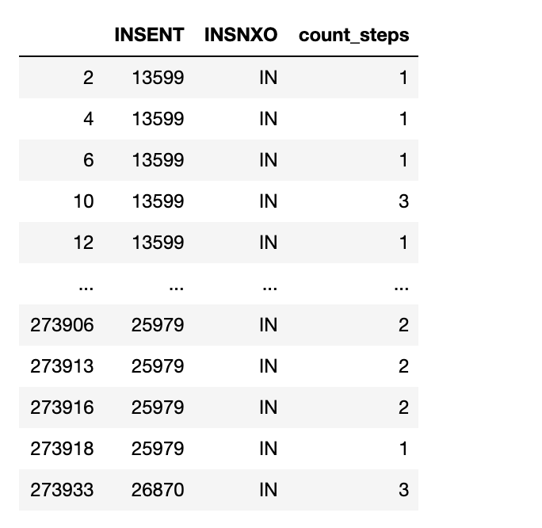
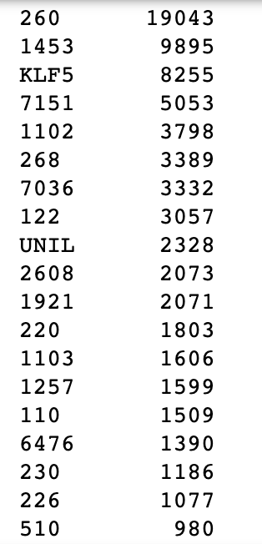
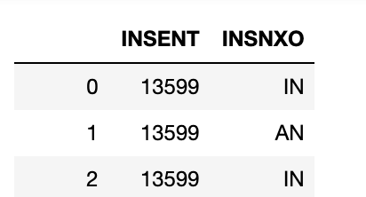
Part3: New Feature Creation
1
INALLY
2
count_steps
3
Yield_Loss
Value
Frequency
Yield loss=(start weight-finish weight)/start weight
Use the first digit → Much closer to the business meaning
Count Ignored Steps between Two ‘IN’ Status

Slide 12
Part3: Select Suitable Features for Model Building
Adopt Three Methods for Feature Engineering
Comparison of Three Methods
Filter Method
Overfitting
1
Simplicity: uses ranking technique and rank ordering method for variable selection; not including any mining algorithm;
Example: Pearson’s Correlation, Anova;
XXX
Wrapper Method
Embeded Method
Embeded Method
2
Filter Method
Iterative: take care of each iteration of the model training process;
Penalization: L1, L2;
Non-ML based
ML based
Wrapper Method
3
ML Based : needs one machine learning algorithm and uses its performance as evaluation criteria;
Example: forward selection, backward elimination;
Underfitting

Slide 13
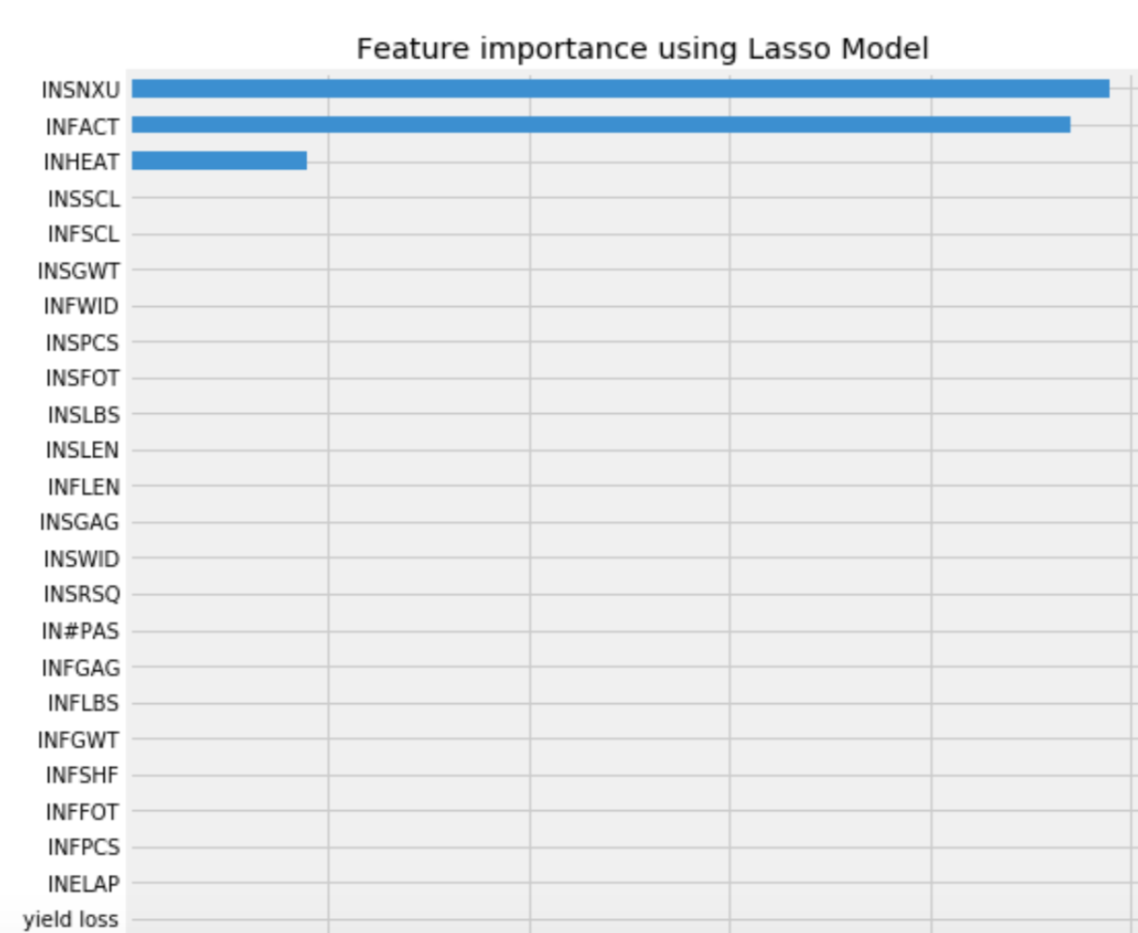
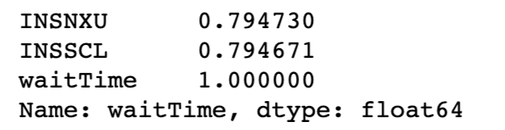
Part3: Results from Three Methods and Final Feature Selection
1. Filter Method
2. Embeded Method
3. Wrapper Method
Backward Elimination
Recursive Feature Elimination
INSNXU
INFACT
INHEAT
INDENS INSGAG INSPCS INFAG
INFPCS INSSCL IN#PAS INALLY
Appeared two times!

Slide 14
Predictive Model Selection
Part4: Model Selection
11 Relative Attributes
6 Regression Model
3 Evaluation Metrics

Slide 15
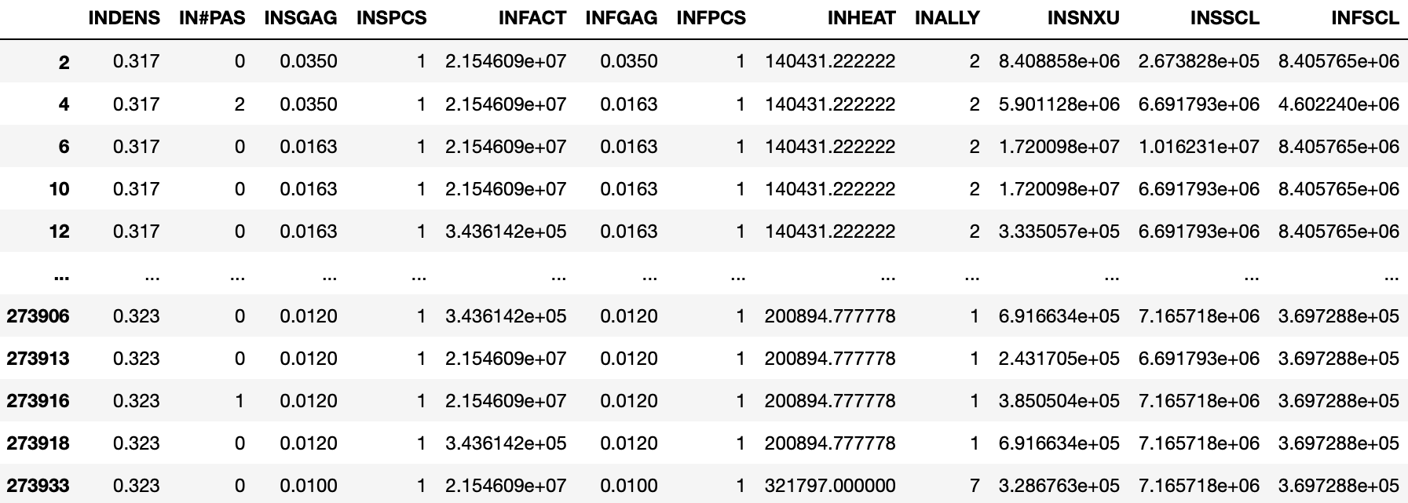
11 relative attributes After Target Encoding
Part4: Model Selection

Slide 16
Part4: Model Selection
MEAN ABSOLUTE ERROR
Sum of absolute differences between our true waiting time
and predicted value.
Range=[ 0, ∞] Lower MAE = model fits better
3 Metrics for
Model Performance Evaluation
R SQUARED
Measure of how close our actual data are to the fitted regression line.
Range=[0,1] Closer to 1 = model fits better
ROOT MEAN SQUARED ERROR
Square root of variance of residuals(prediction errors).
Range=[ 0, ∞] Lower RMSE = model fits better

Slide 17
6 Regression Model
Part4: Model Selection
Linear Regression
K-Nearest Neighbors
Bayesian Ridge Regression
LightGBM
Random Forest
Neural Network

Slide 18
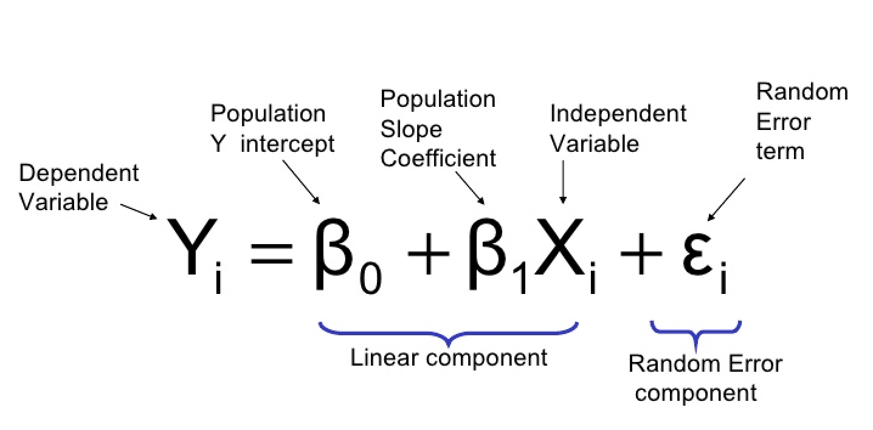
Linear Regression
Part4: Model Selection
Linear Regression is model based on supervised learning.
In this case, it performs the task to predict waiting time of each coil based on given 11 attributes.
MAE | R2 | RMSE
3772.11 | 0.98869 | 14963.68

Slide 19
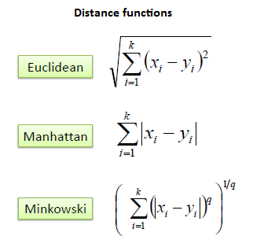
K Nearest Neighbors Regression
Part4: Model Selection
Store all available cases and predict average waiting time of K nearest neighbors based on a similarity measure with almost no learning process.
KNN algorithm
MAE | R2 | RMSE
1830.62 | 0.6235 | 167685.23

Slide 20
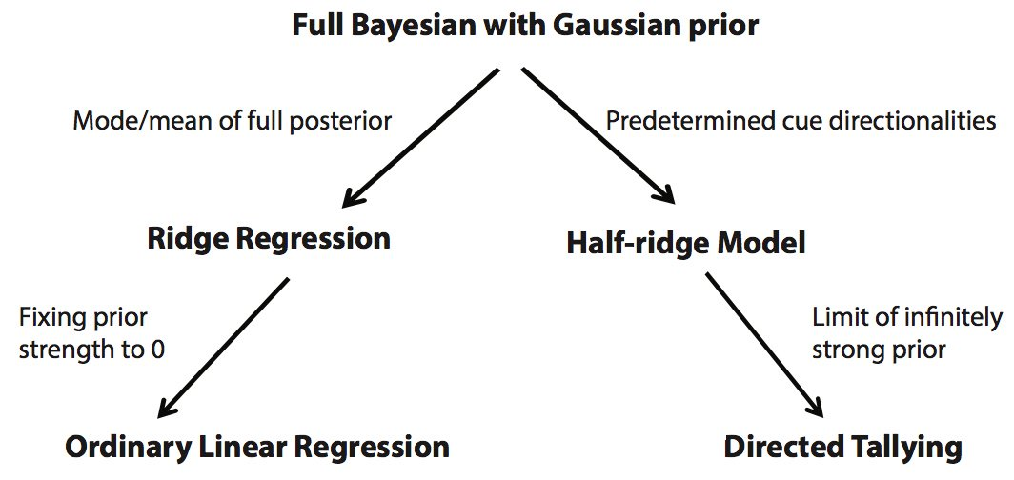
Bayesian Ridge Regression
Part4: Model Selection
A Ridge regression formulated as Bayesian estimator.
Self-adaptive capability avoiding overfitting
2 important hyperparameters: α & λ
MAE | R2 | RMSE
3846.62 | 0.9889 | 14859.94

Slide 21
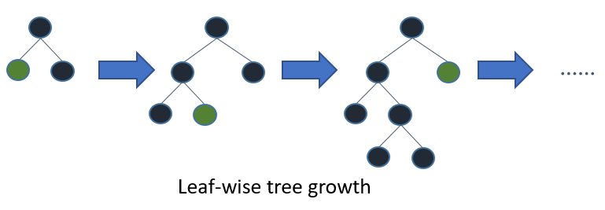
LightGBM
Part4: Model Selection
A gradient boosting framework that uses tree-based learning algorithm
High-Speed data processing
MAE | R2 | RMSE
7860.36 | -29268.17 | 181696.44

Slide 22
Random Forest
Part4: Model Selection
An ensemble learning method for classification, regression and other tasks.
In this case, it’s possible to use random forests model to predict waiting time of each coil.
Mean Absolute Error | R2_Score | Root Mean Square Error
2106.16 | 0.9997 | 2110.09

Slide 23
Neural Network
Part4: Model Selection
Neural networks are a set of algorithms, modeled loosely after the human brain, that are designed to recognize patterns. We can use this method to predict waiting time because of its complexity and accuracy.
MAE | R2_Score | RMSE
1185.73 | -4.99 | 140738.01

Slide 24
Model Performance Comparison
Part4: Model Selection
Model Name | MAE | R2_Score | RMSE
Linear Regression | 3772.11 | 0.98869 | 14963.68
KNN | 1830.62 | 0.6235 | 167685.23
Bayesian Model | 3846.62 | 0.9889 | 14859.94
LightGBM | 7860.36 | -29268.17 | 181696.44
Random Forest | 2106.16 | 0.9997 | 2110.09
Neural Network | 1185.73 | -4.99 | 140738.01

Slide 25
Part 5: Summary & Conclusion
EDA
Wait time for machine 78 is the longest and machine 22 and 44 is the shortest (0 Hour).
The wait time of on-schedule orders is almost half of wait time of delay orders
A1, AK(Alloy) coils are more likely go to the long wait machine
Recommendation
Buy more machine 78 if budget permits
Some machine 22 and 44 may be unused in production since the wait time is 0
Adjusting the delivery date according to the predictive wait time can reduce order delay
Predictive Model
Random Forest model has the best performance and can be used in wait time prediction

Slide 26
THANK YOU

Slide 27
Appendix - timeline
Feb. 24-Mar. 1
Mar. 2-8
Mar. 9-15
Mar. 16-22
Mar. 23-29
Mar. 30-Apr. 5
Apr. 6-12
Apr. 13-19
Apr. 20-26
Apr. 27-30
Communicated with coach about the topic and decided specific direction to work on together
Held several online meetings, brainstorming on methods of working out problems
Finished basic work such as cleaning the data, completing feature engineering work and EDA work
Finished first draft presentation and moved to next stage
Worked individually on different models using Python: Linear Regression, KNN, Bayesian, LightGBM, Random Forest and Neural Network
Continuously worked on elaborating model to get the best performance(e.g. accuracy) and compared the model to pick out the best
Started working on visualization part, used Sankey Diagram to show the project results
Prepared executive summary(report), coding script and final presentation slides
Rehearsed continuously for the final presentation on April 30
Scope of Work
Spring Break
First meeting with Coach
Second meeting with Coach
Draft Presentation
Third meeting with Coach
4rh meeting with Coach
Presentation Rehearsal Feedback
We are here!
Final Presentation

